Slide 1
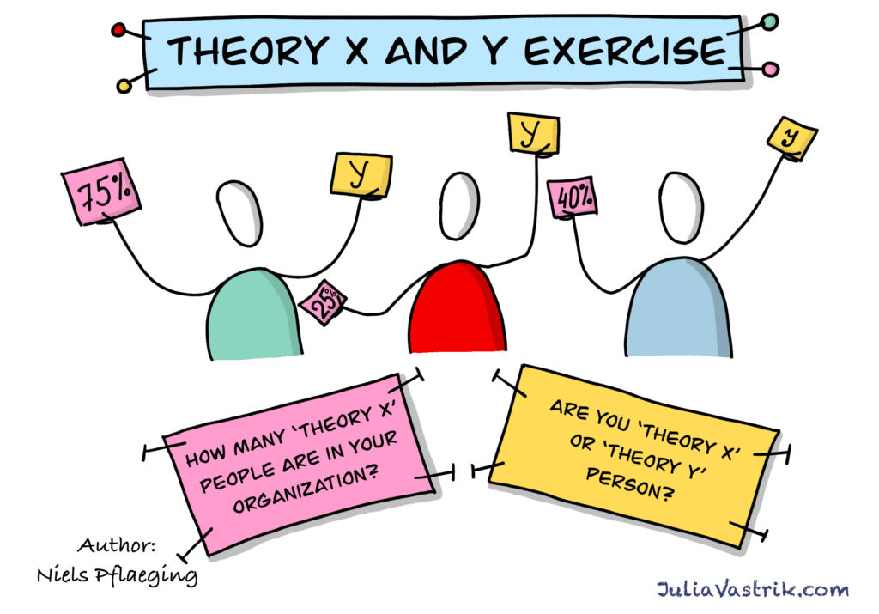
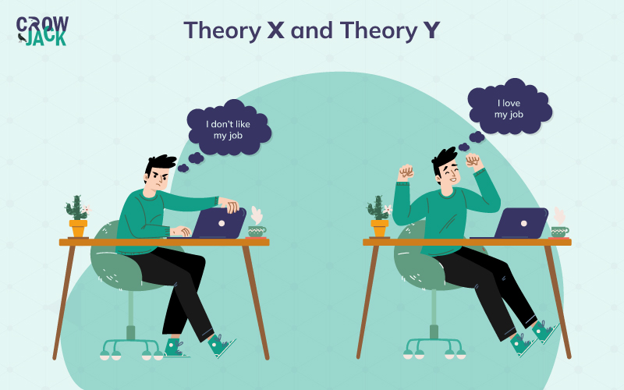
THEORY X AND THEORY Y : UNDERSTANDING MANAGEMENT STYLES
Name: M. Pravallika
PGDM, Batch 2025
Subject: Organizational Behavior
Instructor: Prof. K.L Revathi .

Slide 2
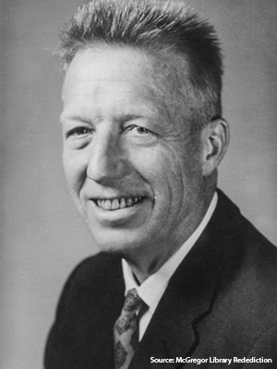
WHAT ARE THEORY X AND THEORY Y?
Theory X assumes employees dislike work, are lazy, avoid responsibility, and need strict supervision and control to perform.
Theory Y assumes employees enjoy work, are self-motivated, seek responsibility, and can work independently with trust from managers.
Theory X managers use authoritarian, micromanaging styles with rewards and punishments to motivate employees.
Theory Y managers use participative, supportive styles, encouraging creativity and involvement in decision-making.
Theory X is suited to routine, controlled environments; Theory Y fits innovative, collaborative workplaces.

Slide 3

THEORY X – KEY POINTS
Assumes employees naturally dislike work and will avoid it whenever possible.
Believes employees lack ambition, avoid responsibility, and need to be closely supervised.
Thinks employees need external motivation through rewards or punishments to perform.
Management style is authoritarian, relying on strict control and supervision.
Common in environments with repetitive tasks or where tight control is necessary, like factories or assembly lines.

Slide 4

THEORY Y - KEY POINTS
Assumes employees are self-motivated, enjoy their work, and seek responsibility.
Believes employees can be creative, take initiative, and work independently.
Management style is participative and supportive, encouraging collaboration.
Trusts employees to make decisions and contribute ideas to improve the workplace.
Best suited for jobs requiring innovation, creativity, and employee involvement.

Slide 5


EXAMPLES OF THEORY X AND THEORY Y
Example Of Theory X
Example Of Theory Y

Slide 6
THE SHIFT AND ITS BENEFITS
From Control to Trust: Managers move from closely supervising and controlling employees (Theory X) to trusting them to work independently and take responsibility (Theory Y).
From Pessimism to Optimism: Instead of assuming employees dislike work and avoid responsibility, managers believe employees are motivated, enjoy work, and seek growth.
From Directive to Participative: Managers begin involving employees in decision-making and encourage them to share ideas and creativity.
From Extrinsic to Intrinsic Motivation: The focus shifts from rewards and punishments to fostering personal fulfillment and job satisfaction.

Slide 7
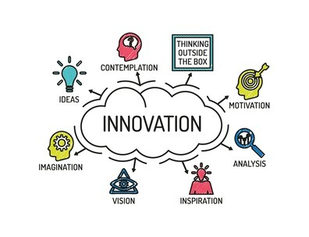

Increased Employee Motivation and Engagement: Employees feel valued and trusted, leading to higher effort and productivity.
Better Creativity and Innovation: Employee involvement sparks new ideas and problem-solving.
Improved Workplace Culture: More open communication and collaboration lead to job satisfaction and lower turnover.
Higher Loyalty and Retention: Empowered employees are more committed to the company’s success.
Effective Use of Talent: Utilizing employees’ skills and knowledge enhances performance and growth.

Slide 8
WHEN TO USE EACH THEORY
When to Use Theory X:
In environments that require strict supervision and control, such as manufacturing, factories, or assembly lines.
When tasks are routine, repetitive, and require precision without deviation.
In high-risk or safety-critical industries (e.g., nuclear plants, military, air traffic control) where compliance is essential.
During crises or emergency situations demanding quick, top-down decisions.
When managing inexperienced or untrained employees who need close guidance.

Slide 9
When to Use Theory Y:
In workplaces that depend on creativity, innovation, and problem-solving, such as tech companies, design studios, or research organizations.
Where employees are knowledgeable, skilled, and motivated to take initiative.
In professional, service-oriented and collaborative environments, promoting teamwork.
When fostering a positive workplace culture that encourages participation and employee development.
To increase employee engagement and job satisfaction through trust and autonomy.
Managers should assess the situation and blend both theories as needed for optimal results, applying Theory X where control is necessary, and Theory Y to empower and motivate.

Slide 10
ENGAGING QUESTION ??

Slide 11


